Slide 1
MEDIA SHOW
PICTURES TAKEN FROM AFFECTED AREAS AS A RESULT OF THE CHEVRON YARD SPILL IN DELTA STATE
PERIOD: 25TH ,26TH ,27TH & 28TH OF JULY AND 4TH ,5TH & 6TH OF AUGUST, 2010
AREAS: EKPAN , OGBORIKOKO, OGBOROKE, NEW LAYOUT & ELEGBETE IN DELTA STATE, NIGERIA

Slide 2
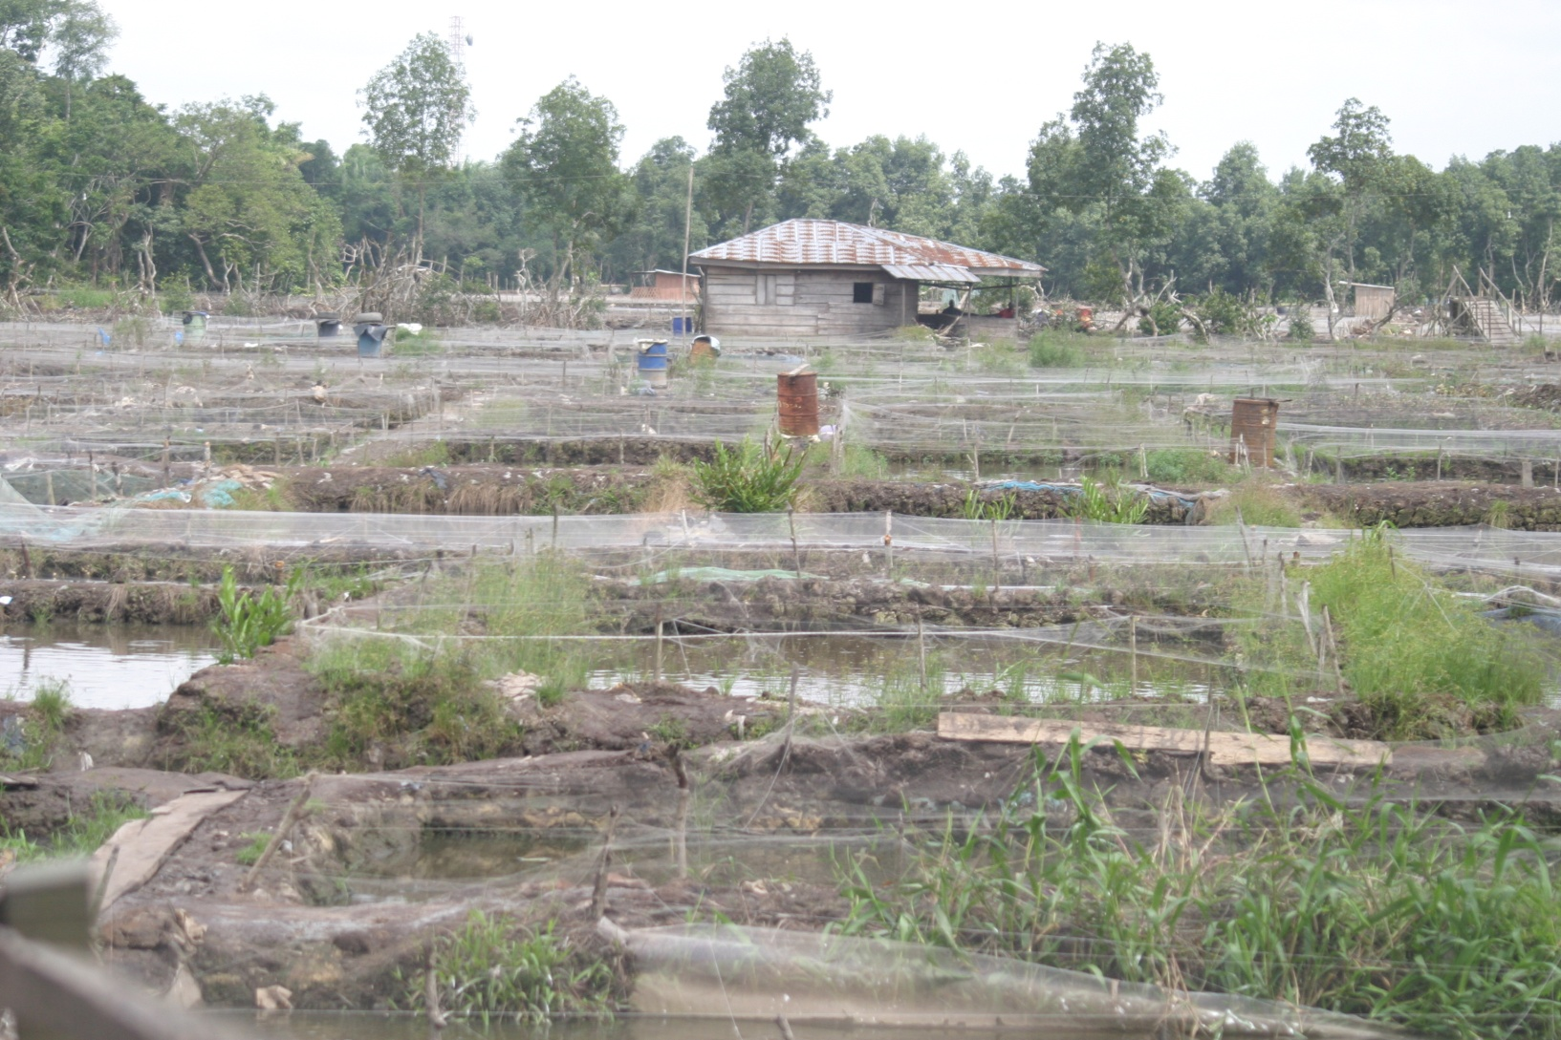
A SECTION OF CLUSTER ONE OF THE FISH FARMS EKPAN , UVWIE LOCAL GOVERNMENT DELTA STATE, NIGERIA

Slide 3
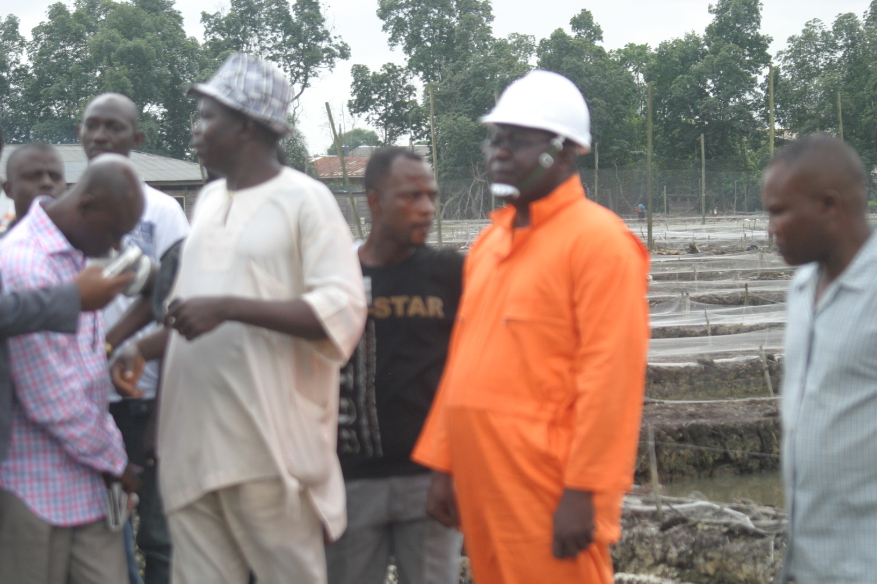
THE HON. COMMISSIONER OF ENVIROMENT DELTA STATE( SECOND RIGHT) IN CLUSTER TWO IN THE CAUSE OF MITIGATION / ON –THE- SPOT ACESSEMENT.

Slide 4
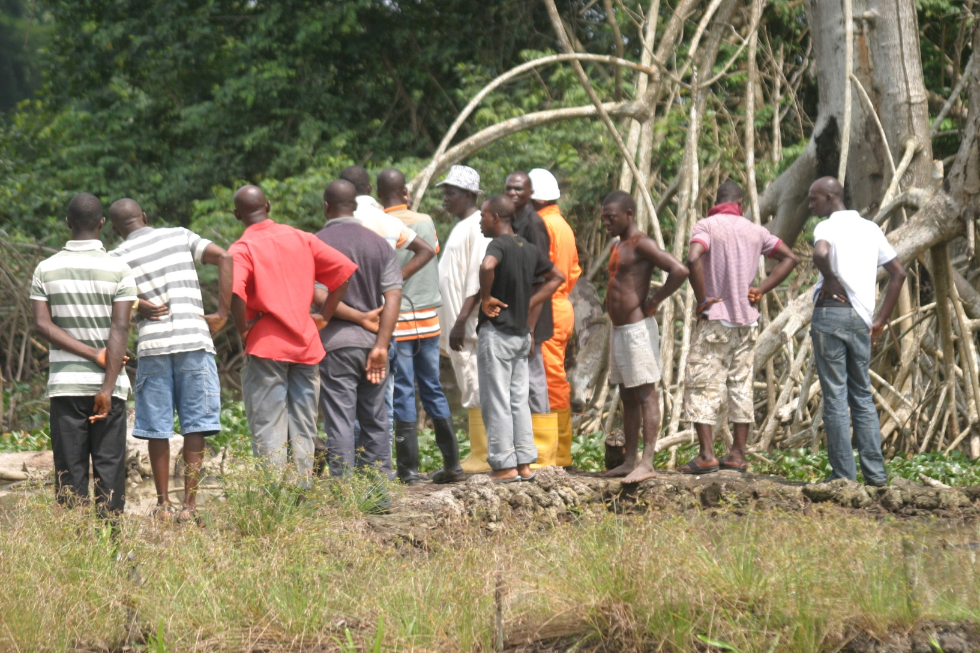
THE HON. COMMISSIONER FOR ENVIROMENT DELTA STATE IN COMPANY OF THE FISH FARMERS INSPECTING ONE OF THE AFFECTED SITES

Slide 5
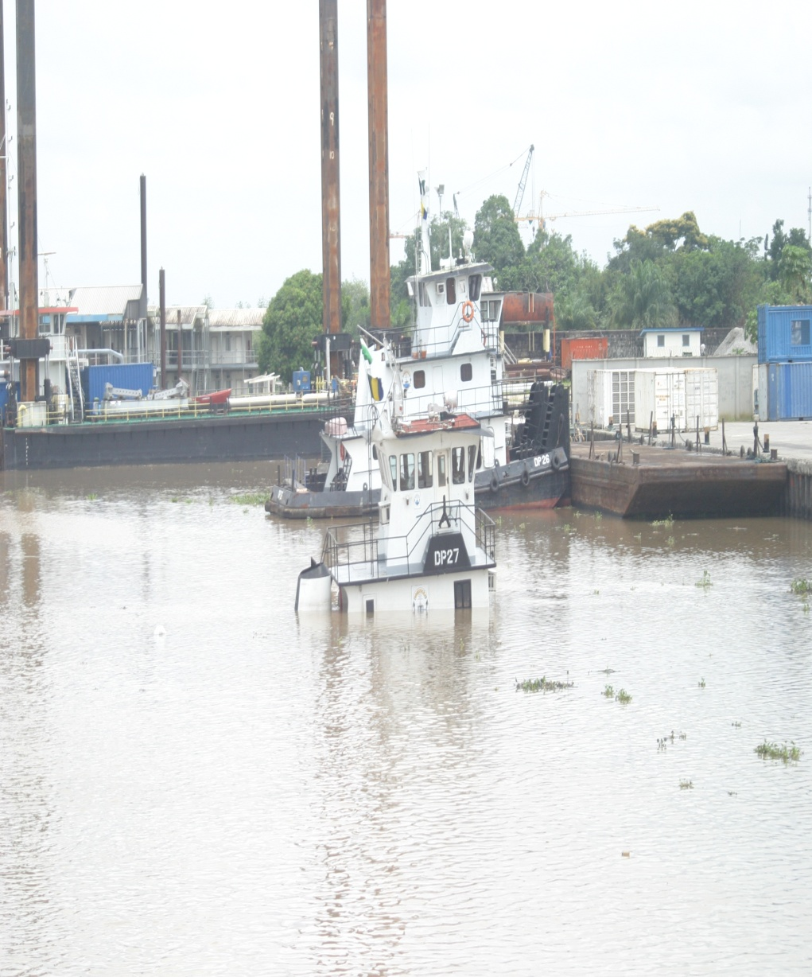
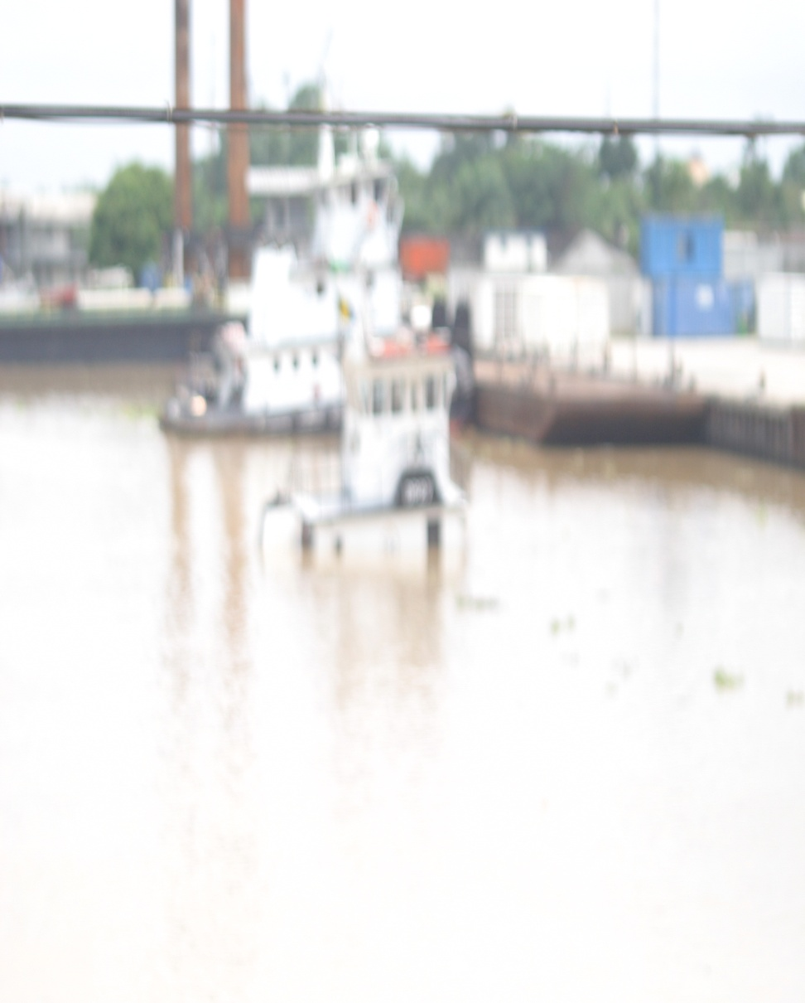
TRACING THE ORIGIN OF THE SPILL TO CHEVRON NIGERIA LIMITED DOCK YARD

Slide 6
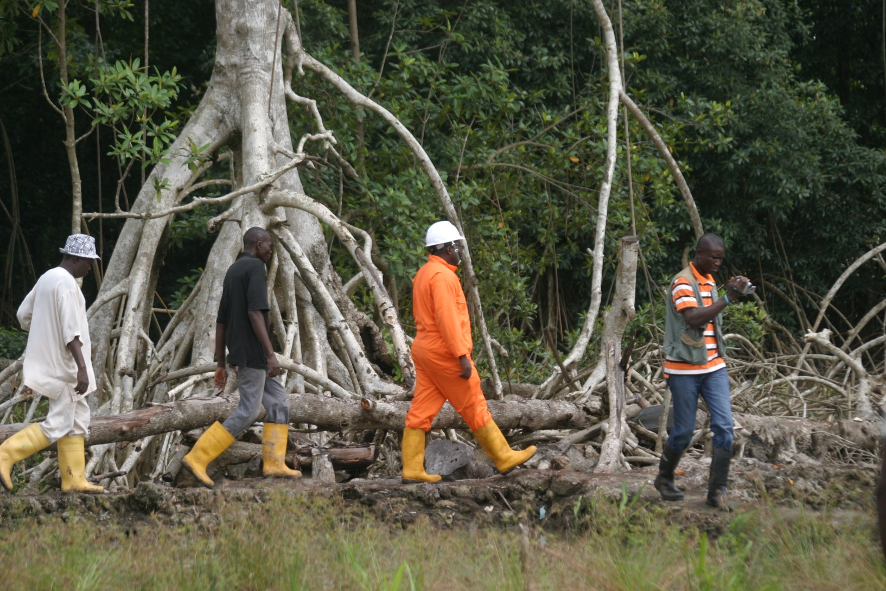
INPECTION CONTINUES IN ANOTHER SITE

Slide 7
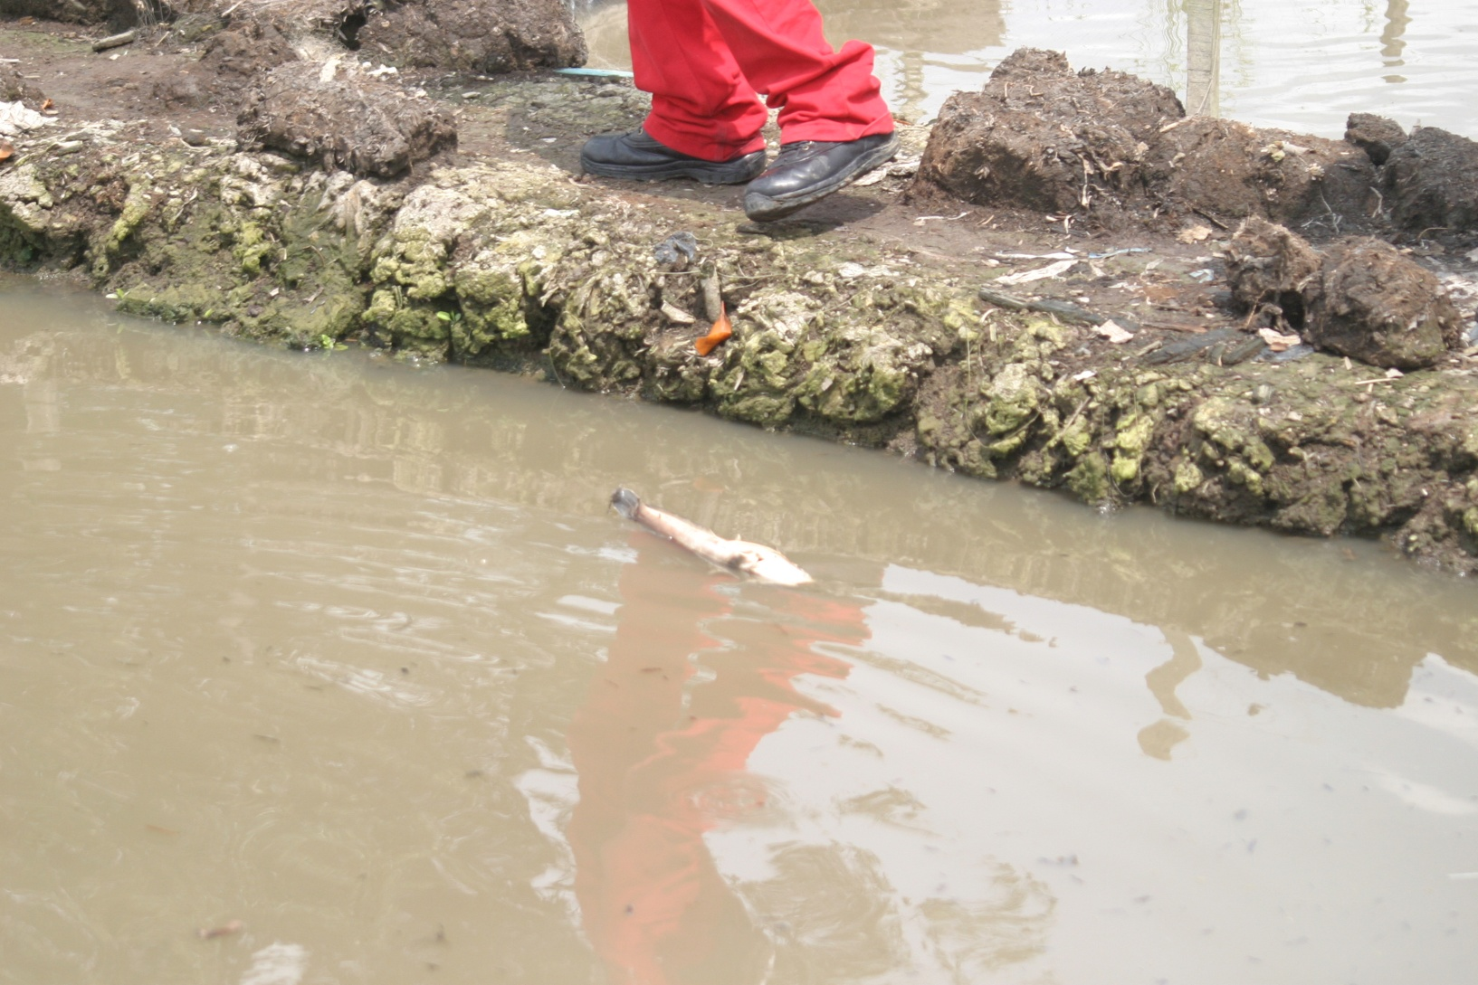
DEAD FISH FLOATING IN THE POLUTED POND

Slide 8
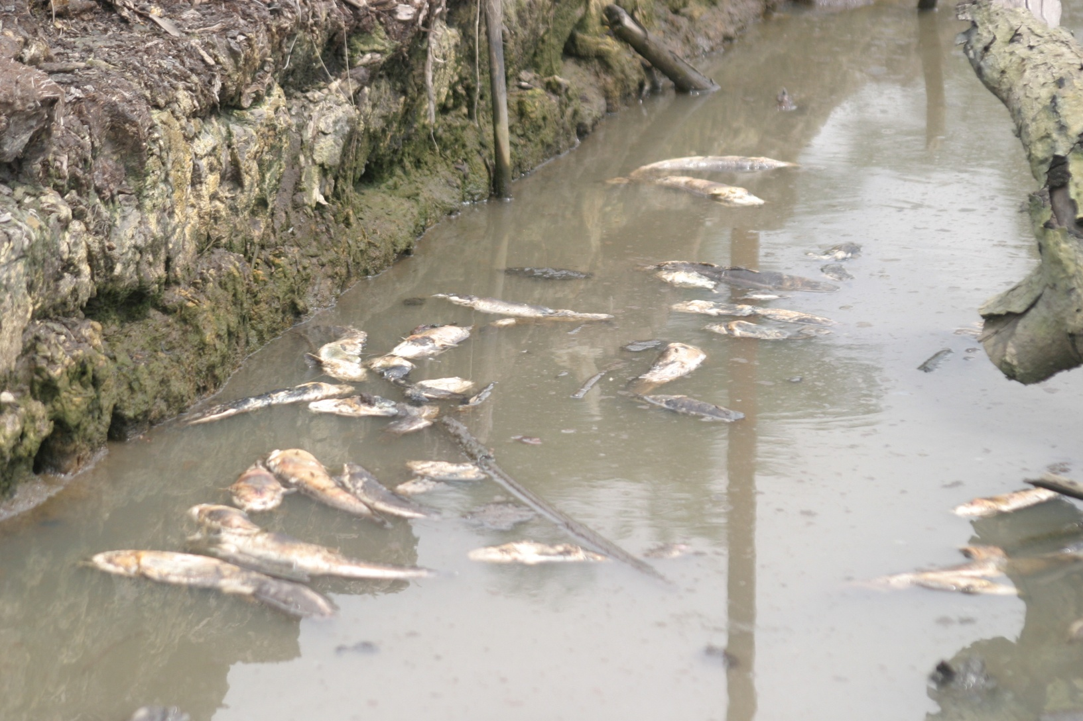
DEAD FISHES FLOATING IN THE POLUTED POND

Slide 9
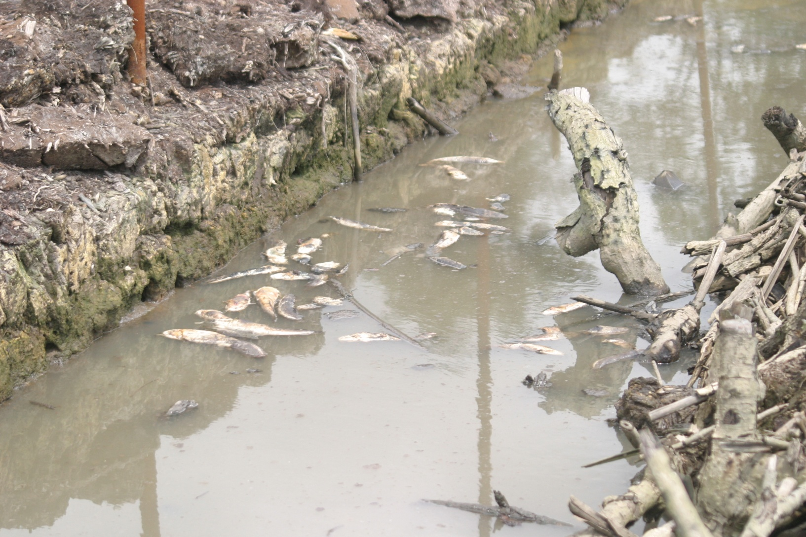
DEAD FISHES FLOATING IN THE POLUTED POND

Slide 10
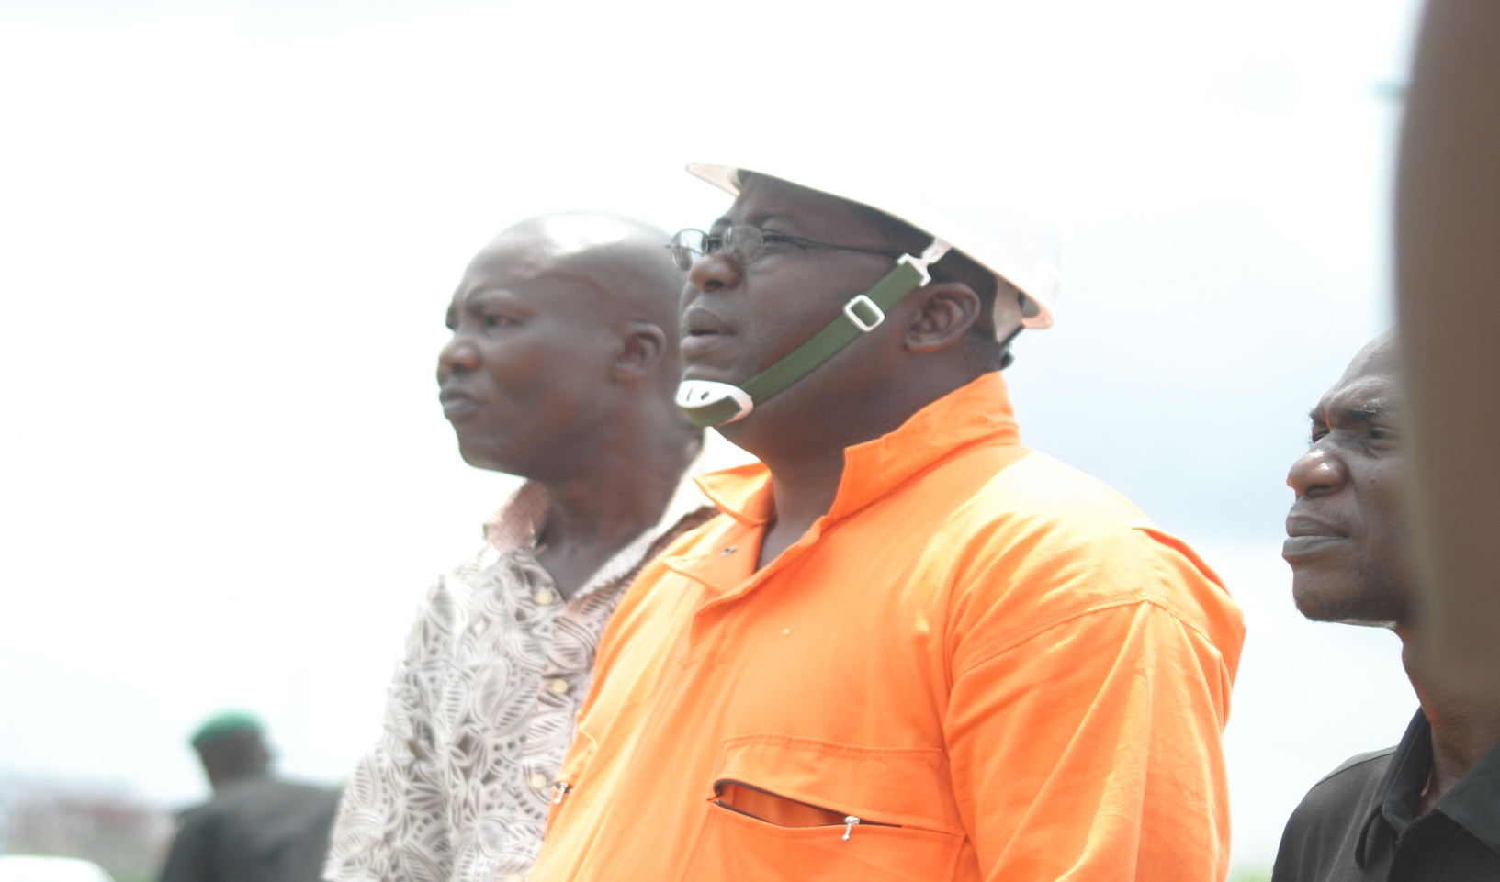
THE HON. COMMISSIONER FOR ENVIROMENT DELTA STATE LEADING AN INTER - MINISTERIAL COMMITTEE ON ENVIROMENTAL POLLUTION/ RISK REDUCTION IN THE AFFECTED COMMUNITIES

Slide 11
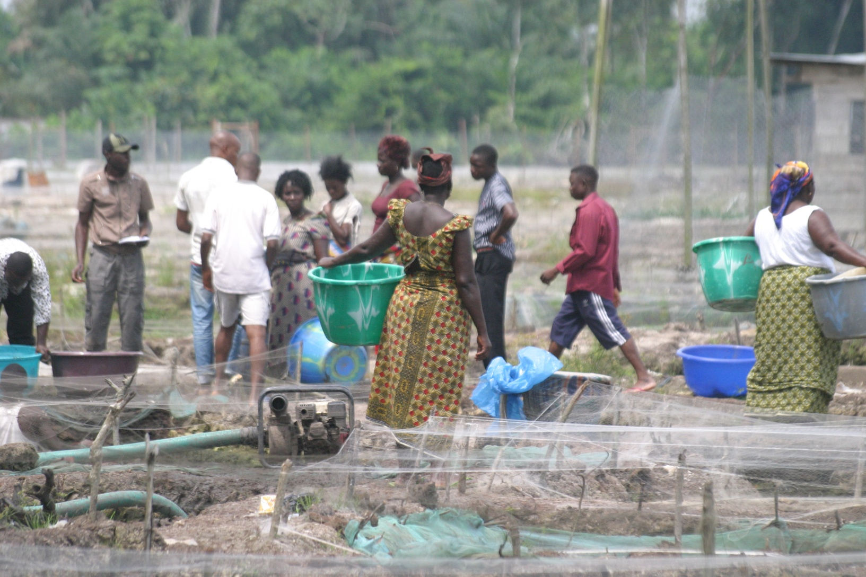
FISH FARMERS TAKING STOCK / SEPERATING DEAD FISHES

Slide 12
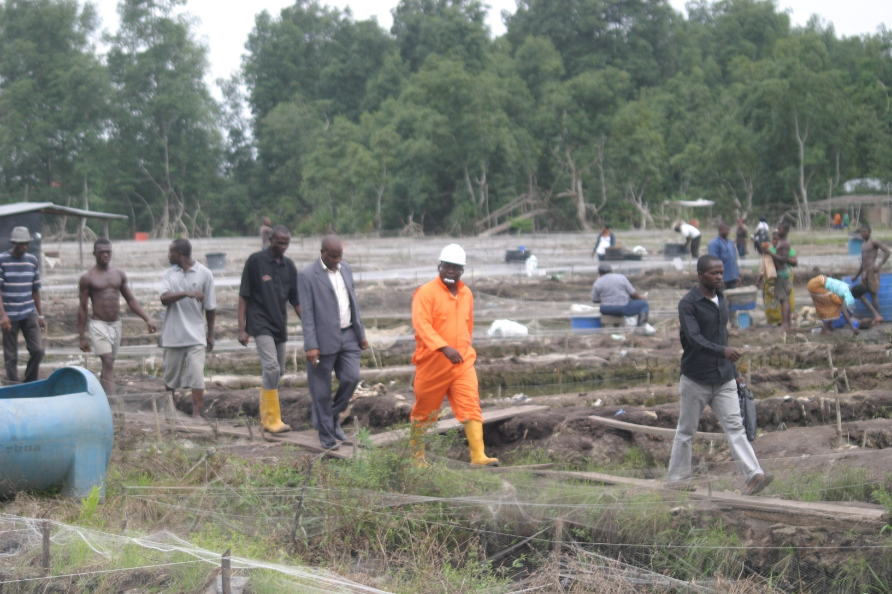
HON.COMMISSIONER FOR ENVIROMENT AND THE INTER MINISTERIAL COMMITTEE INSPECTING IMPACT OF THE SPILL IN ONE OF THE CLUSTERS IN THE EKPAN FISH FARMS

Slide 13
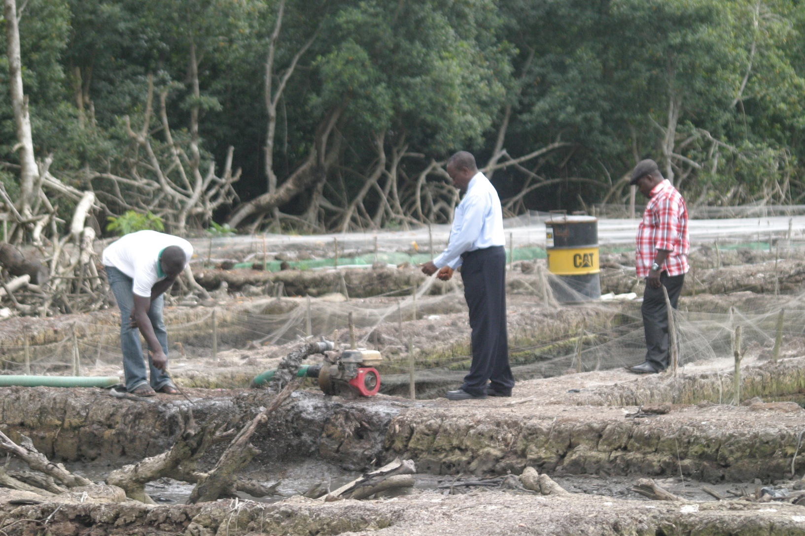
EXPERTS COLLECTING SPECIMENS FOR LABORATORY ANALYSIS

Slide 14
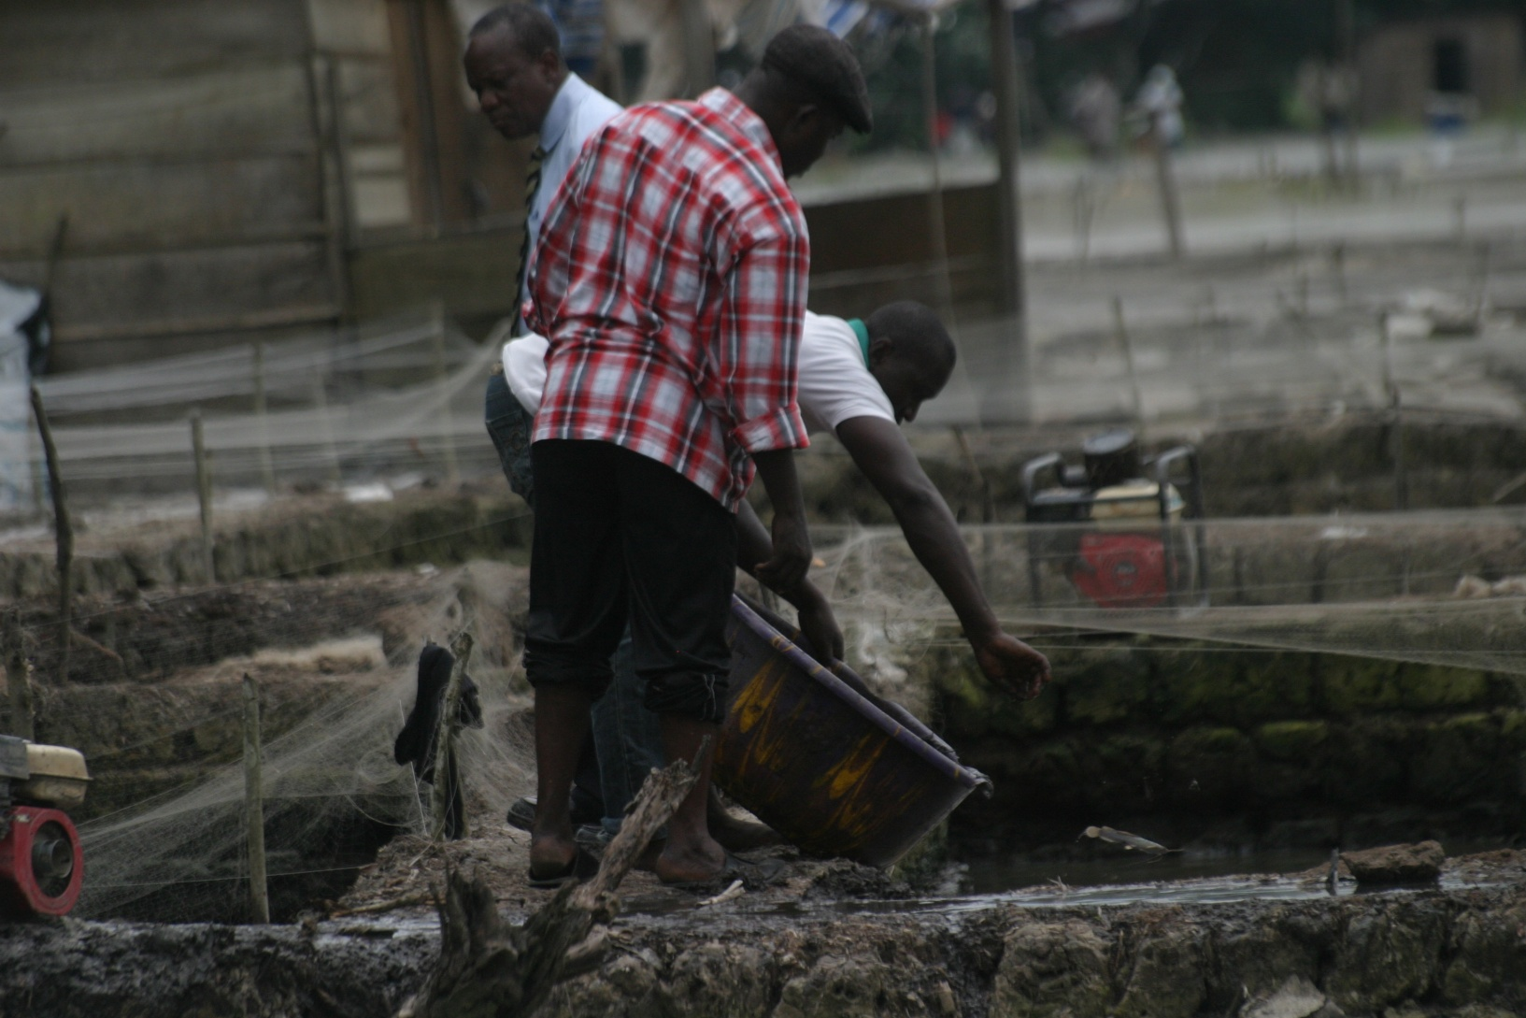
EXPERTS COLLECTING SPECIMENS FOR LABORATORY ANALYSIS

Slide 15
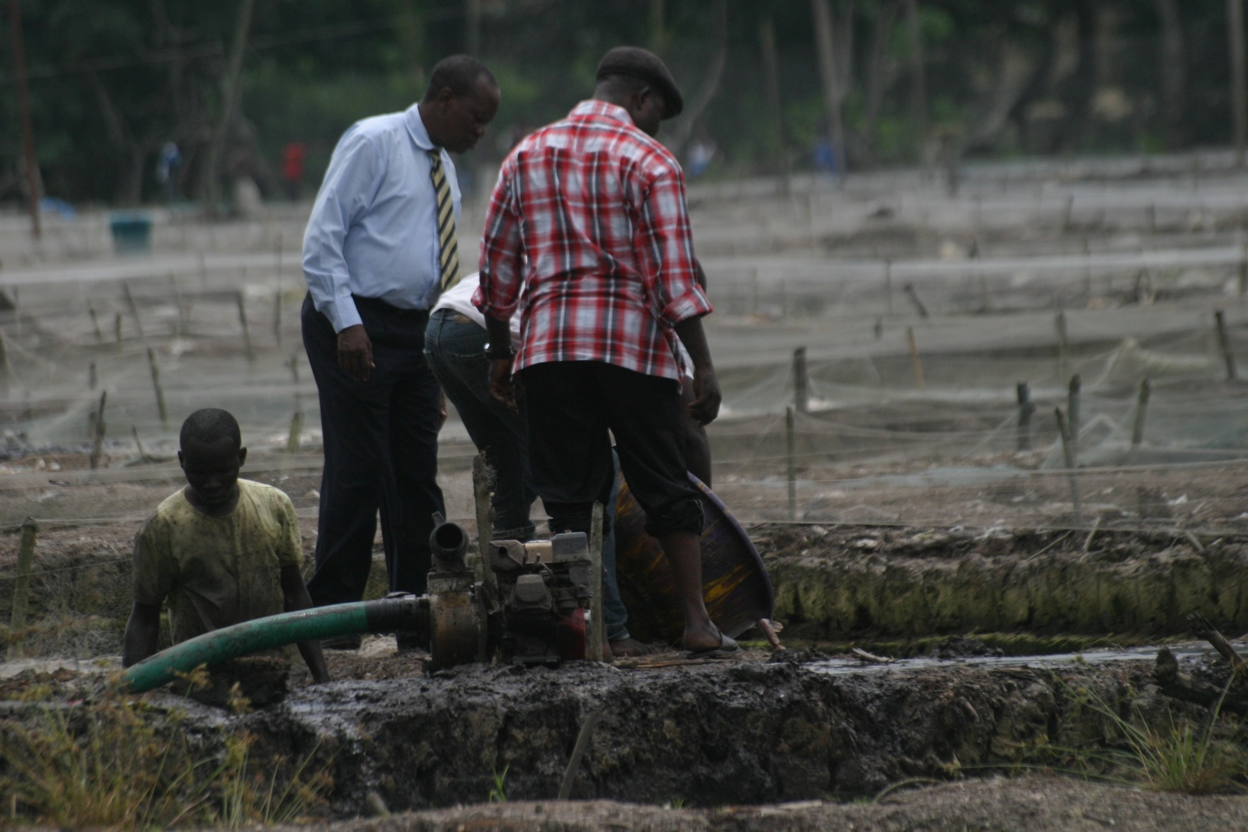
EXPERTS COLLECTING SPECIMENS FOR LABORATORY ANALYSIS

Slide 16
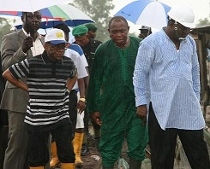
HIS EXECELLENCY, THE DEPUTY GOVERNOR PROF. AMOS ATUAMA (SAN) DURING HIS INSPECTION

Slide 17
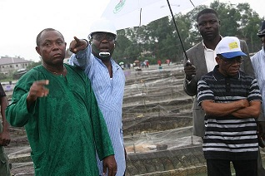
HIS EXECELLENCY, THE DEPUTY GOVERNOR PROF. AMOS ATUAMA (SAN) SHOCKED AT THE LEVEL OF DEVASTATION DURING HIS INSPECTION

Slide 18
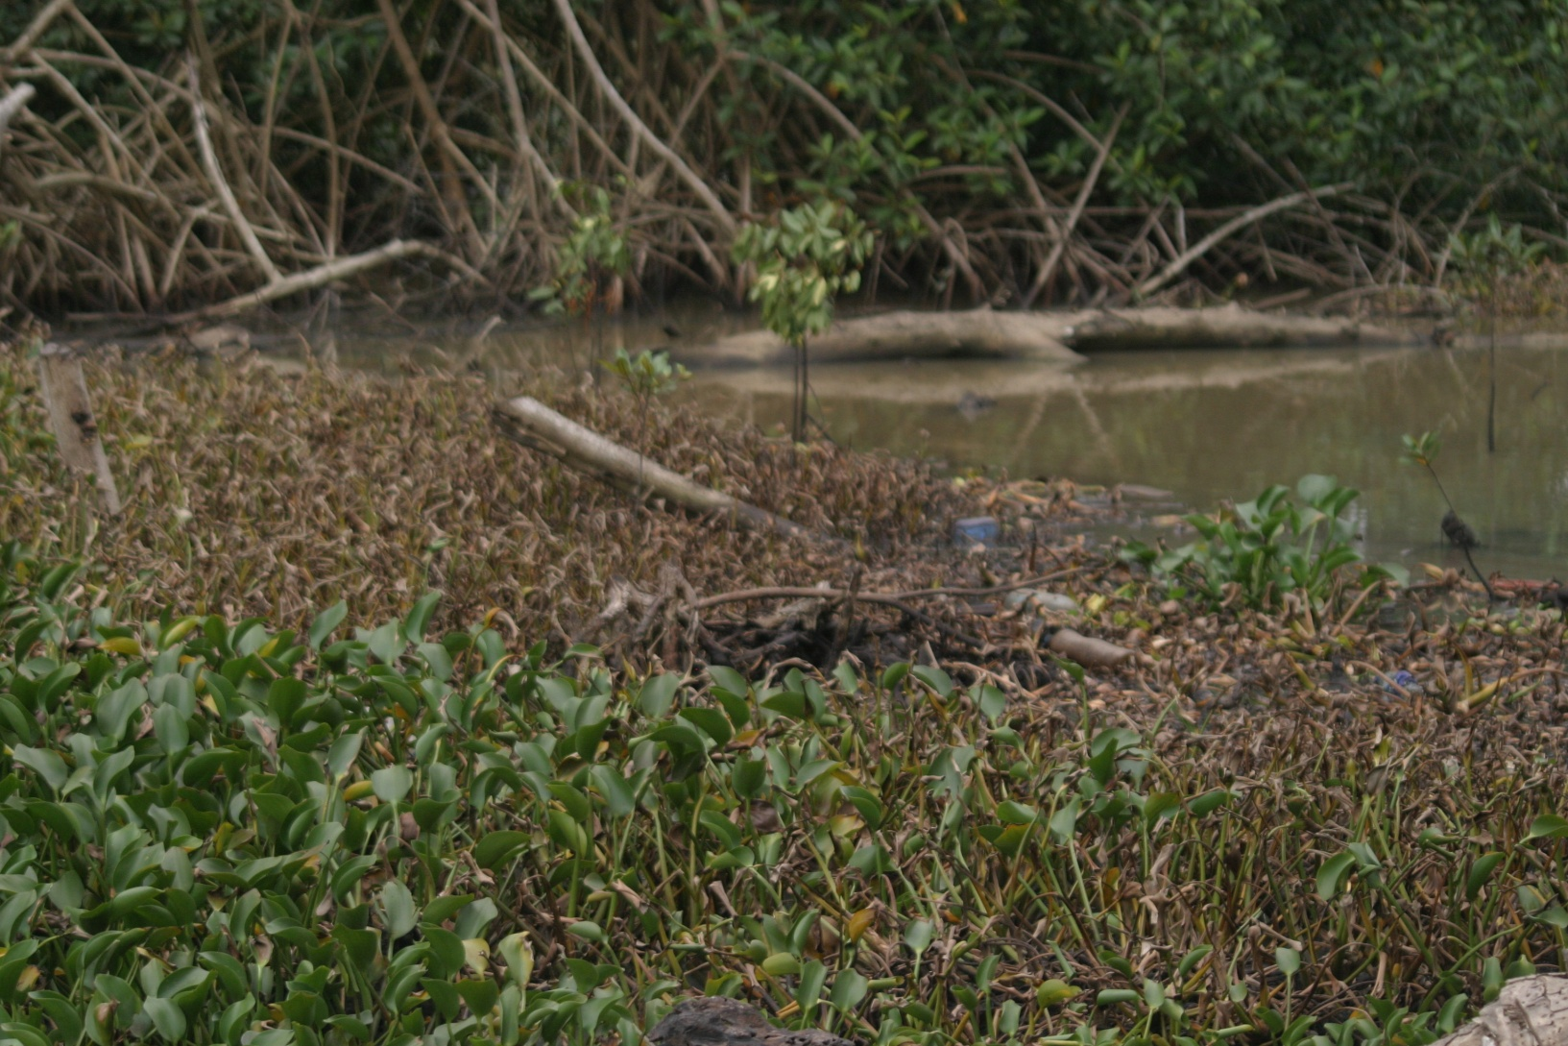
SPILL DIVERSTATED SWAMP

Slide 19
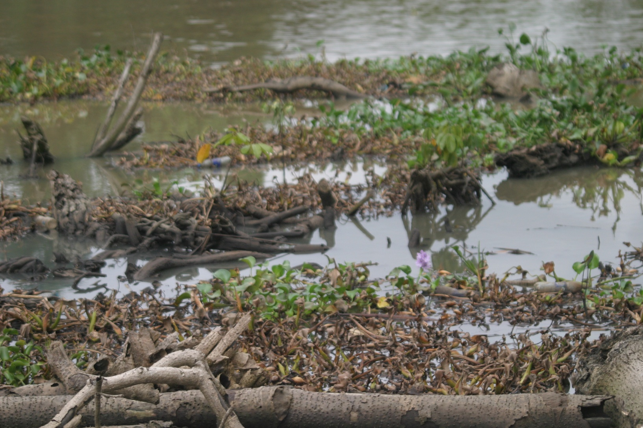
AQUATIC COMMUNITY DISTROYED BY THE SPILL

Slide 20
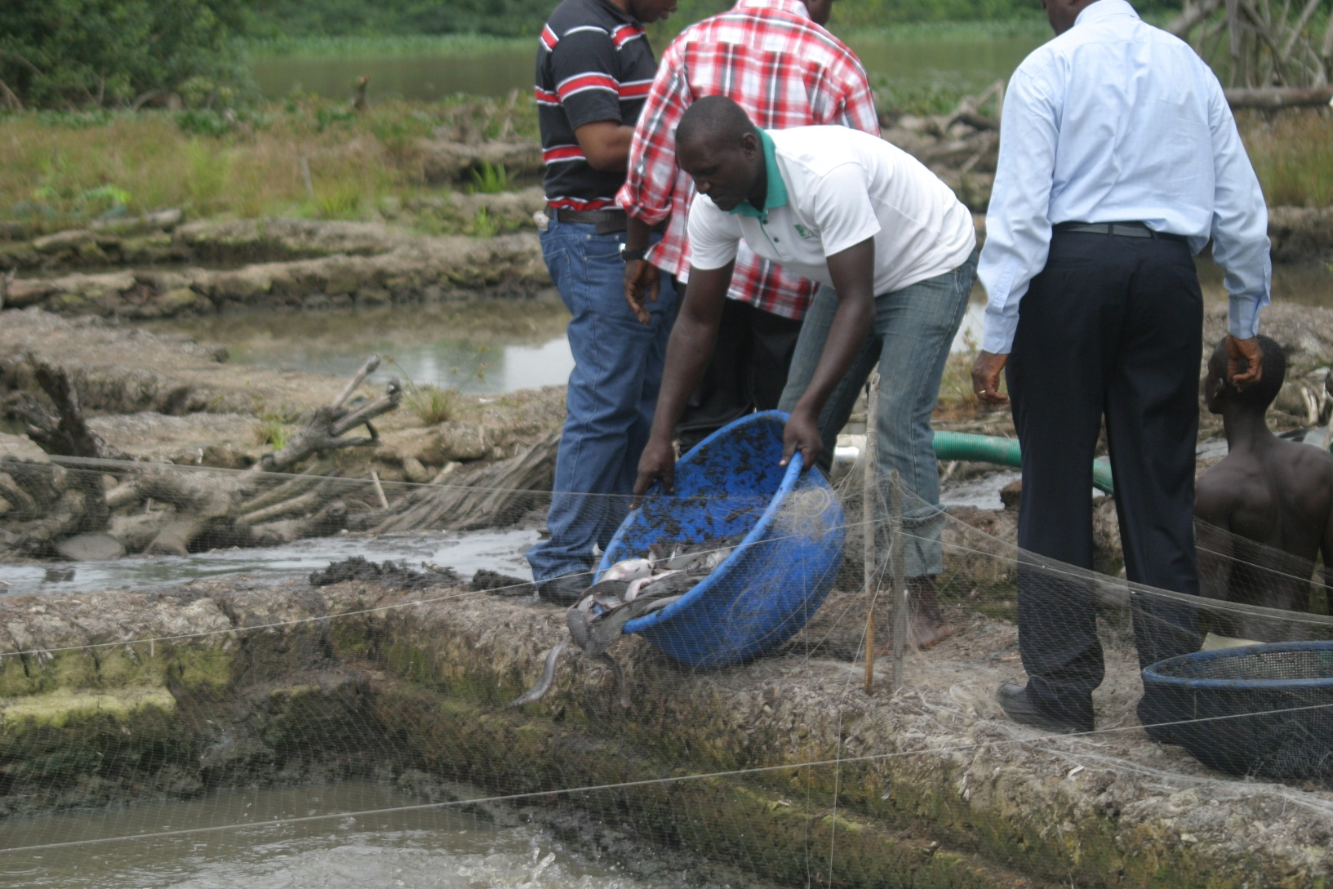
FISH FARMERS COUNTING THEIR LOSS

Slide 21
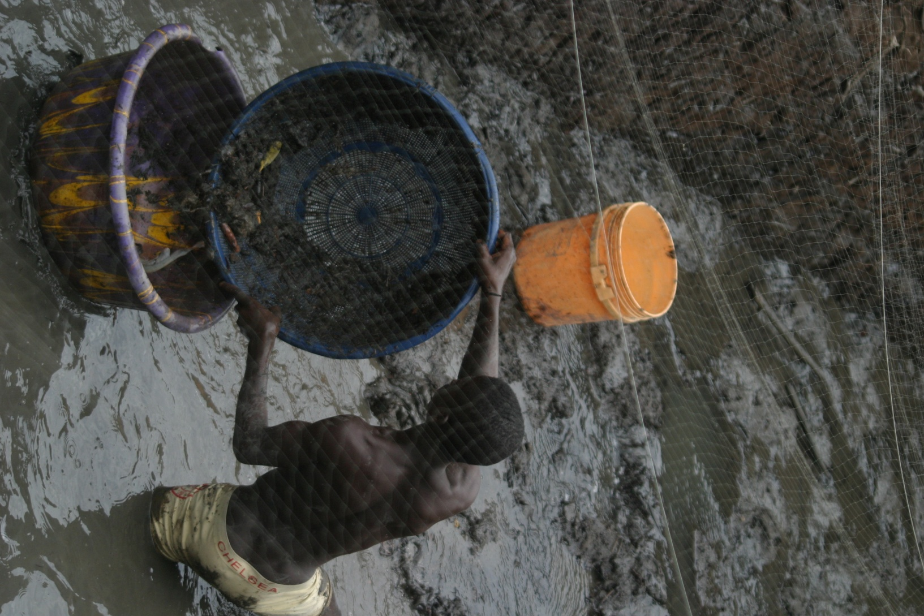
FISH FARMERS COUNTING THEIR LOSS

Slide 22
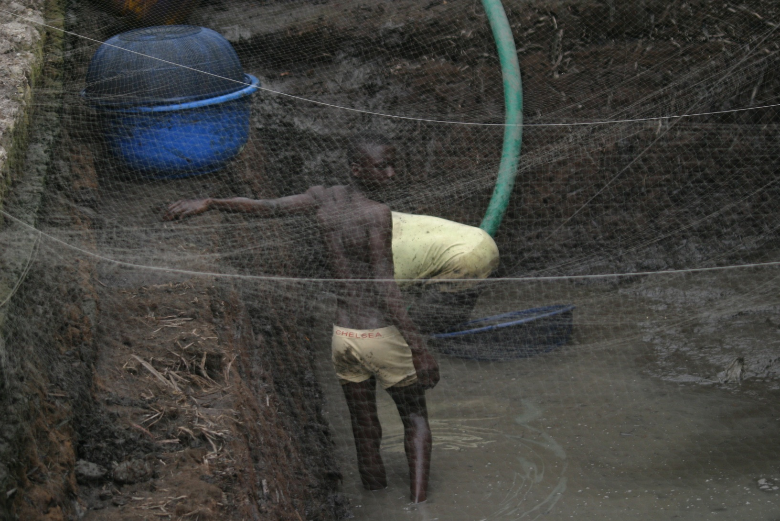
FISH FARMERS COUNTING THEIR LOSS

Slide 23
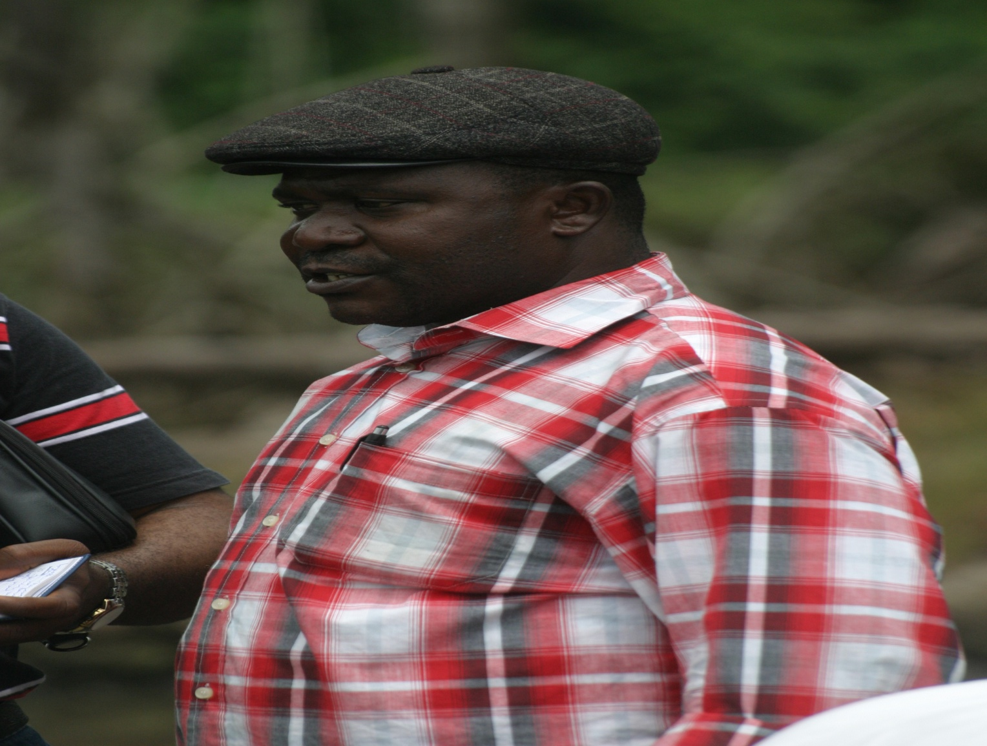
A MEMBER OF THE PRESS CREW IN THE HON. COMMISSIONER ENTOURAGE

Slide 24
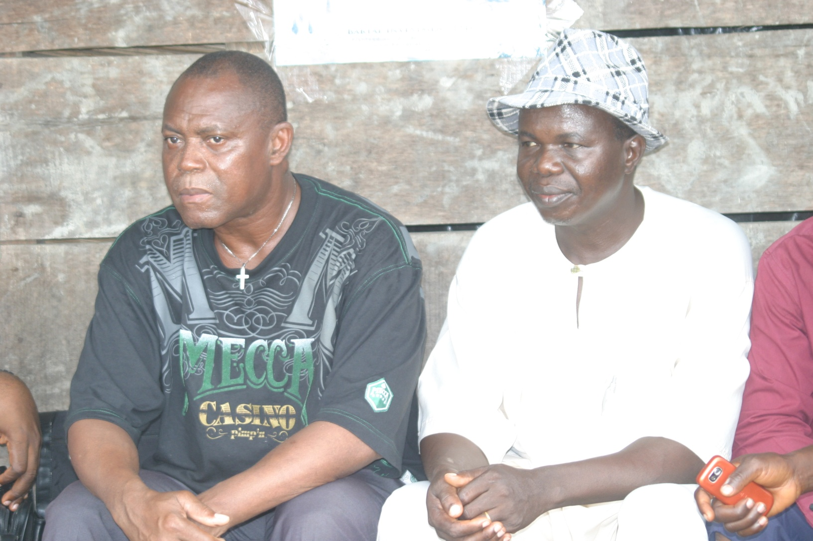
SOME MEMBERS OF THE BOARD OF TRUSTEES OF THE FISH FARMERS

Slide 25

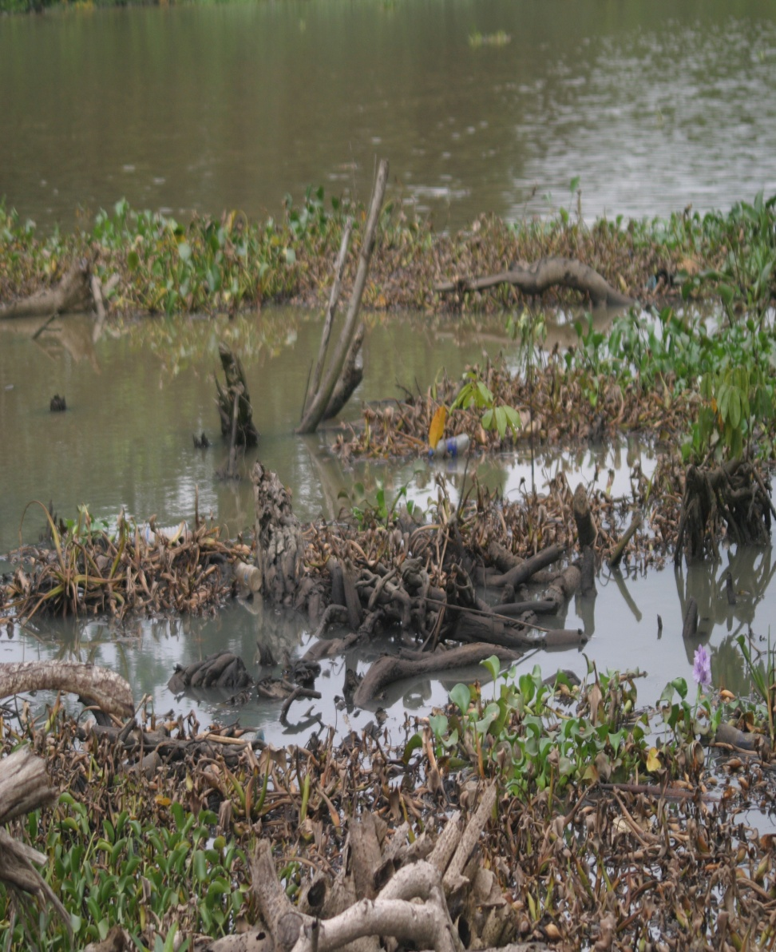
AND IMPACT CONTINUES

Slide 26

THANK YOU

